Slide 1
High-Flow Nasal Cannula
Leslie Herrmann MD
& lots of friends…

Slide 2
Disclaimer & Thanks
Portions of this talk were shamelessly stolen from Glenn Stryjewski, PICU physician extraordinaire, with his permission. Slides with the ANMC logo on the bottom were “borrowed” from him.
Assistance also came from Susan Romero, PICU NP extraordinaire.
Thank you to Clifton Dalton for sending me the hot-off-the-presses LifeMed recommendations.
In some places, I have over-simplified complex concepts in the interest of time. I am happy to forward Glenn’s entire talk to anyone who wants more detail.
You Tube has several helpful videos on setting up HFNC.

Slide 3
Historical Background at YKHC
YKHC got its first HFNC machine in 2015.
Before 2015, when we had babies and young children with impending respiratory failure, we would either intubate or humidify regular NC and go as high as 4-5 L while awaiting arrival of LifeMed; LifeMed would then initiate HFNC.
Both options were far from ideal – often, babies were either under- or over-treated.

Slide 4
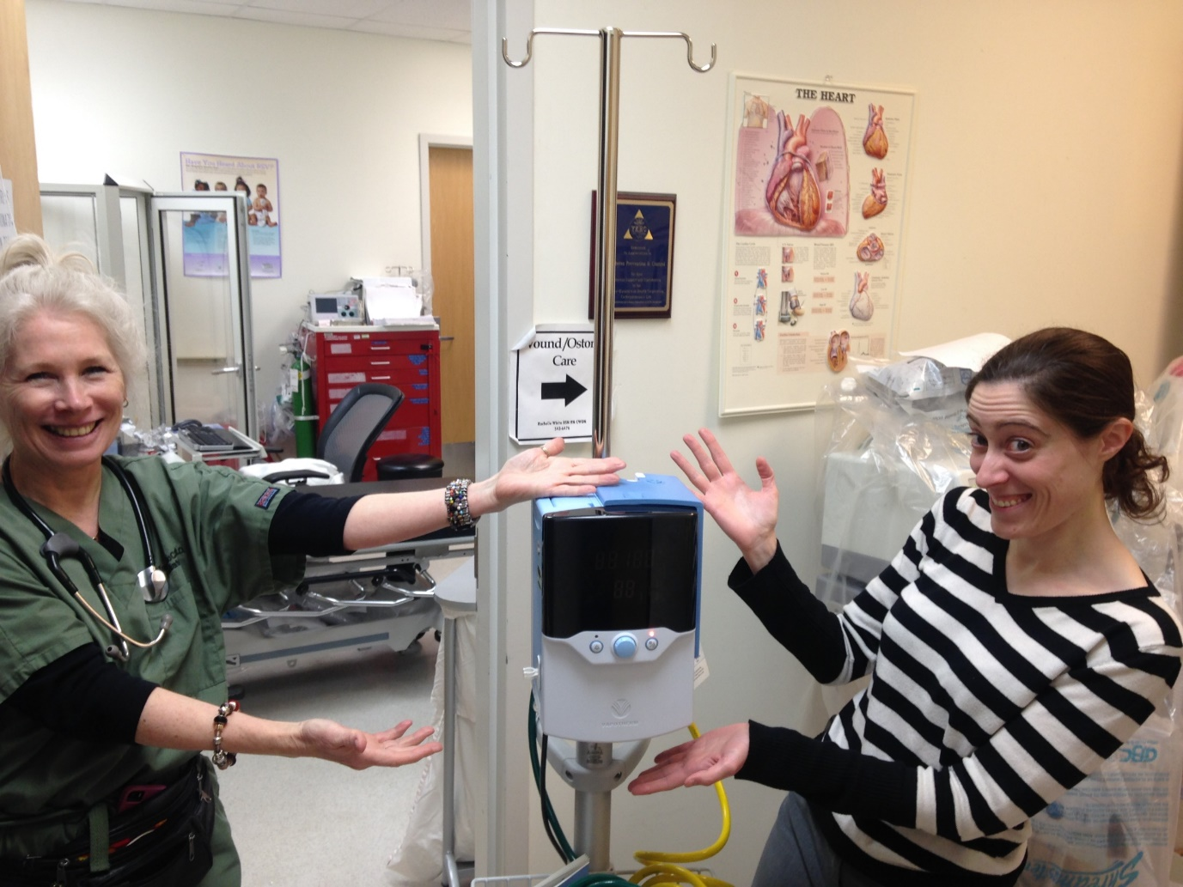
Historical Background
In 2015…

Slide 5
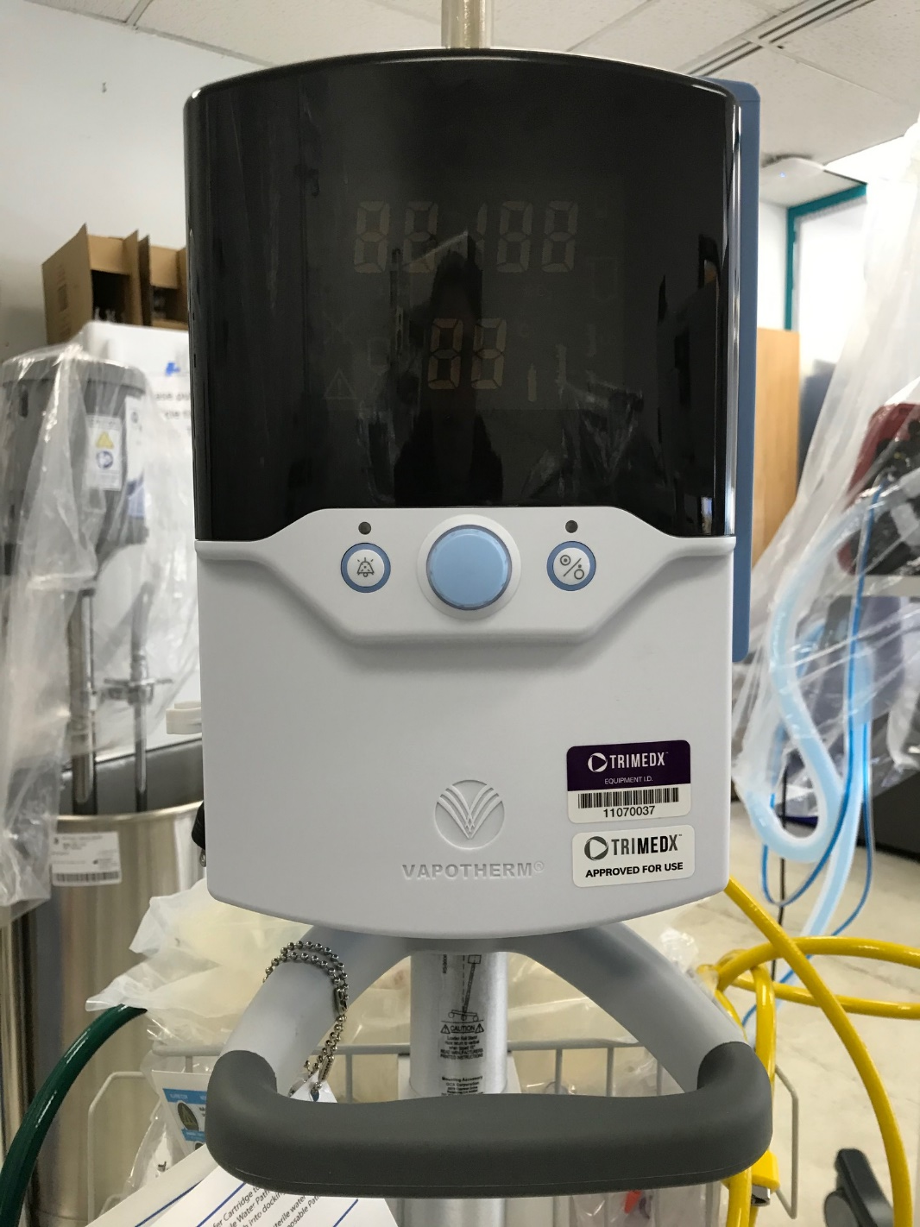
Hello.
I am a HFNC machine.

Slide 6
What does HFNC do?

Slide 7
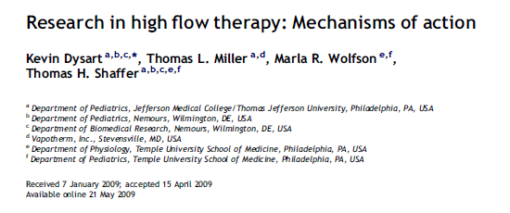
Proposed mechanisms of HFNC
Washout of nasopharyngeal dead space
Reduction of inspiratory resistance (work of breathing) by providing adequate flow
Improved mechanics by supplying adequately warmed and humidified gas
Reduction in the metabolic cost of gas conditioning
Provision of distending pressure (maybe)

Slide 8
Dead space
We all remember this, right?
Dead space: the portion of each tidal volume that does not take part in gas exchange (per Johns Hopkins Medicine).
At the beginning of each inspiration, the dead space is filled with expired air. (Expired air has less oxygen and more carbon dioxide than inspired air.)
In many disease processes, physiologic dead space is increased.

Slide 9
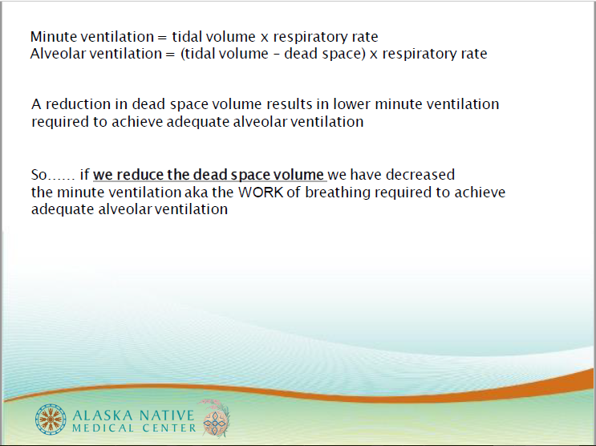

Slide 10
Flushing out the dead space
High flow oxygen “washes out” the expired gas in the dead space.
This reduces CO₂ re-breathing.
Per Glenn, “Flushing of upper airway dead space improves ventilatory efficiency and reduces the work of breathing.”

Slide 11
Proposed mechanisms of HFNC
Washout of nasopharyngeal dead space
Reduction of inspiratory resistance (work of breathing) by providing adequate flow
Improved mechanics by supplying adequately warmed and humidified gas
Reduction in the metabolic cost of gas conditioning
Provision of distending pressure (maybe)

Slide 12
The NOSE
Good things your nose does:
  Humidifies air
  Cleans/filters air
  Warms air
Bad things your nose dose:
  “The distensibility of the nasopharynx provides significant resistance on inspiratory relative to expiratory efforts.”
  Gets plugged up by snot

Slide 13
How does HFNC help the NOSE?
“HFT most likely minimizes the inspiratory resistance associated with the nasopharynx by providing nasopharyngeal gas flows that match or exceed a patient’s peak inspiratory flow. This change in resistance translates to a decrease in resistive work of breathing.” (Dysart et al)
“Warmth and humidity keep secretions moist, improve mucociliary clearance, and inhibit inflammatory reactions and nasopulmonary bronchoconstriction reflexes triggered by cold and dry air.” (SCH Clinical Pathway)

Slide 14
Proposed mechanisms of HFNC
Washout of nasopharyngeal dead space
Reduction of inspiratory resistance (work of breathing) by providing adequate flow
Improved mechanics by supplying adequately warmed and humidified gas
Reduction in the metabolic cost of gas conditioning
Provision of distending pressure (maybe)

Slide 15
Below the nose…
COLD + DRY air = BAD
Cold, dry air → protective bronchoconstricting reflex in healthy patients as well as asthmatics
Ventilating with ambient gas (not heated or humidified) → decreased pulmonary compliance and conductance
WARM + WET air = GOOD

Slide 16
Proposed mechanisms of HFNC
Washout of nasopharyngeal dead space
Reduction of inspiratory resistance (work of breathing) by providing adequate flow
Improved mechanics by supplying adequately warmed and humidified gas
Reduction in the metabolic cost of gas conditioning
Provision of distending pressure (maybe)

Slide 17
“Metabolic cost of gas conditioning”
…lots of complicated physiologic formulas about energy consumption…
Basically, it costs the body to warm and humidify air.
Supplying warm, humidified air takes some work away from the body’s workload.
Infants on warm, humidified air gain more weight than those on cold, dry air.

Slide 18
Proposed mechanisms of HFNC
Washout of nasopharyngeal dead space
Reduction of inspiratory resistance (work of breathing) by providing adequate flow
Improved mechanics by supplying adequately warmed and humidified gas
Reduction in the metabolic cost of gas conditioning
Provision of distending pressure (maybe)

Slide 19
What about PEEP?
Does HFNC provide PEEP?
This is controversial.

Slide 20
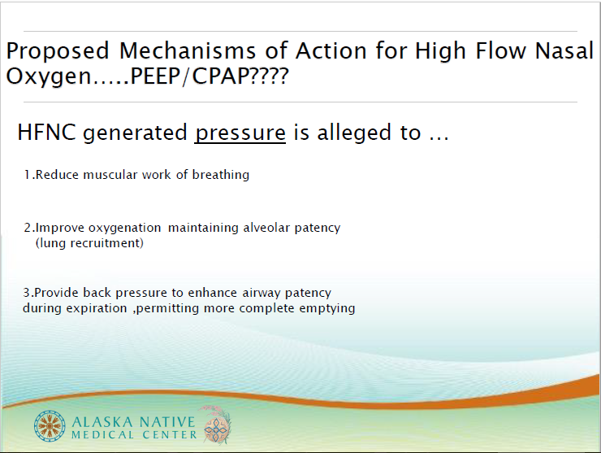

Slide 21
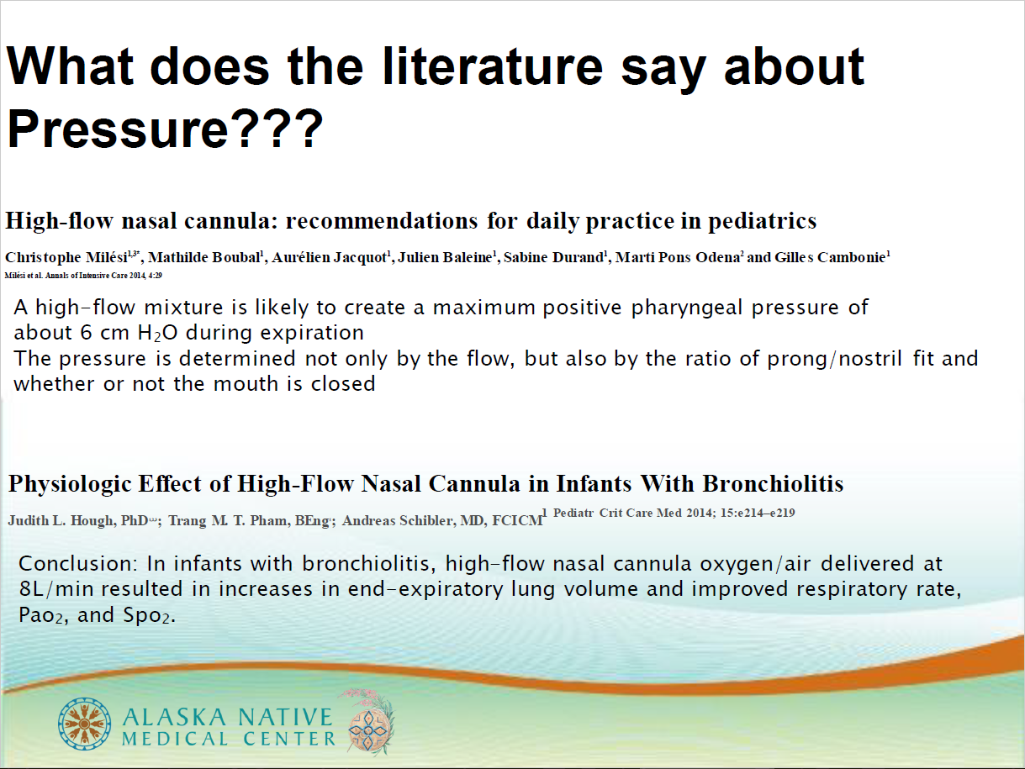

Slide 22
So…does it work?

Slide 23
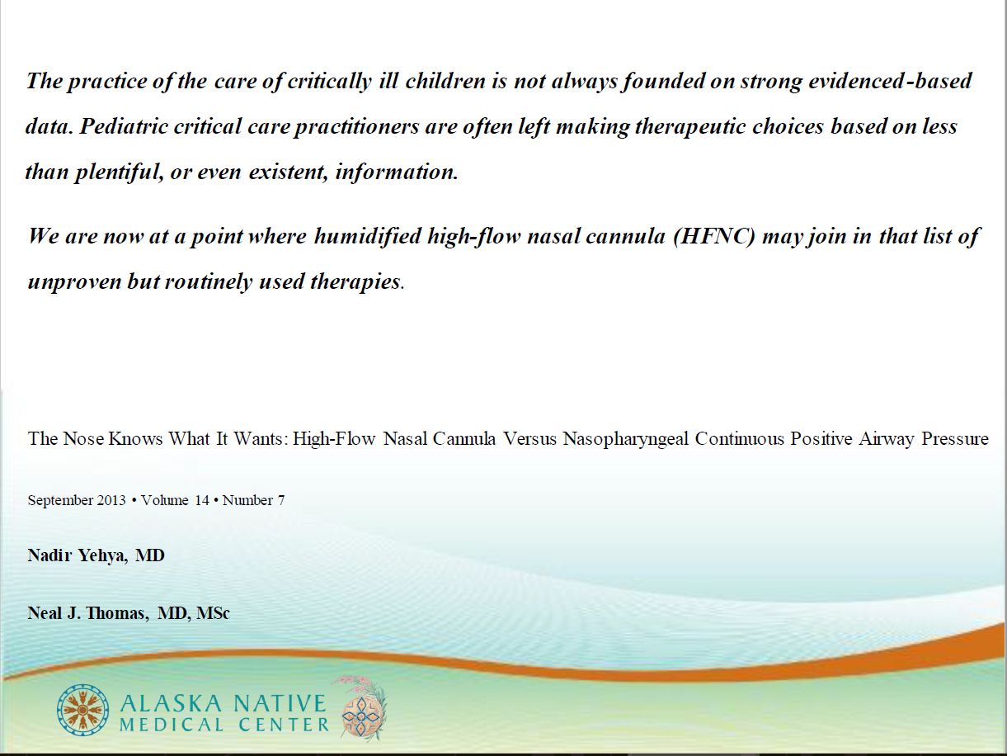

Slide 24
So…does it work?
More emerging studies (with improving methodology) that show decreased rates of intubation in infants with bronchiolitis.
Anecdotally, those of us who were here pre-HFNC all agree: we intubate way less than we used to.
To quote Dr. McClure, “I haven’t friggin’ intubated anyone in over a year, at least! I need to practice! Is there anyone I can practice on?” → In short, WAY LESS THAN BEFORE.

Slide 25
So how do you do it?

Slide 26
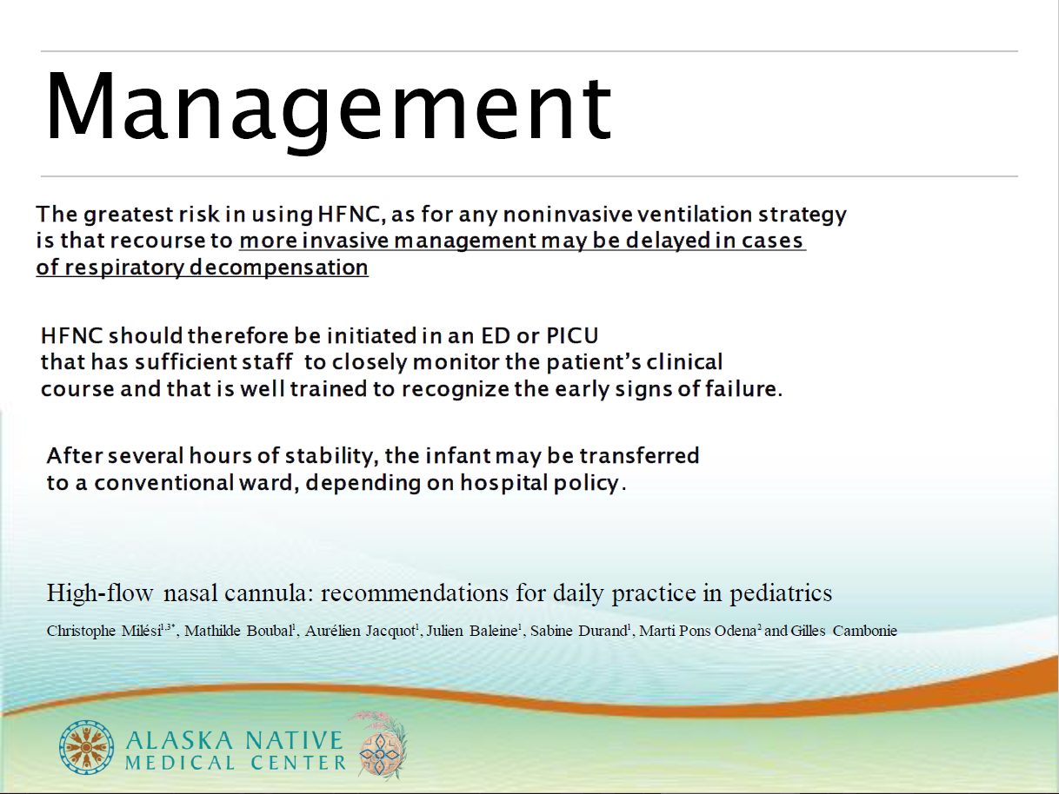

Slide 27
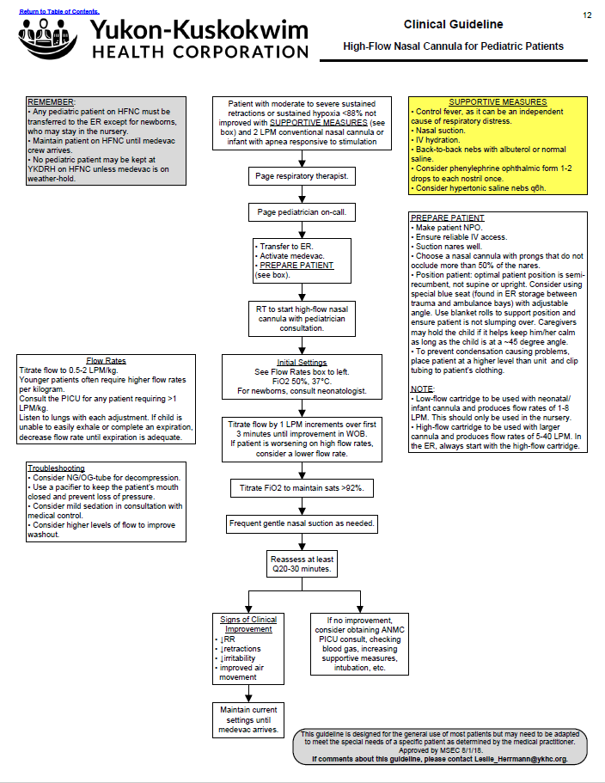

Slide 28
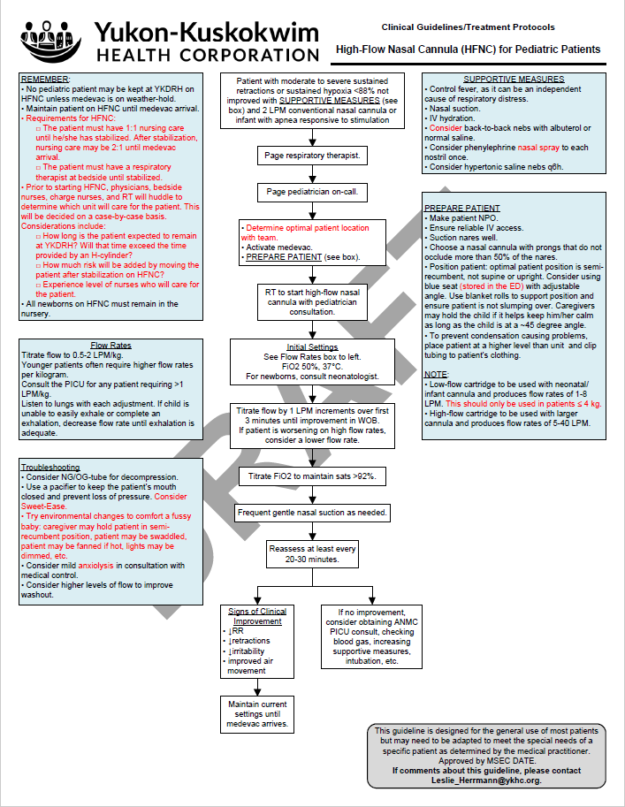

Slide 29
But what if the sky is falling?
BEST PRACTICE: an RT initiates HFNC and is present until the patient is stabilized.
If we are in a worst-case-scenario situation, RED CRISIS, the sky is falling…
We will need to be able to set up and troubleshoot HFNC without an RT at bedside.

Slide 30
What about COVID?
There are evolving recommendations. Stay tuned – things change as frequently as Leslie has to check her temperature!
RSV isn’t going anywhere.
We may not be able to maintain many patients on ventilators. Thus, HFNC may be our best option to keep people alive.
Stay tuned for recommendations about PPE use if using HFNC.

Slide 31
A word about LifeMed
LifeMed has new recommendations.
In cases of confirmed or suspected COVID, they will intubate early.
In cases of negative or low suspicion for COVID, they will consider using HFNC up to 15 L.

Slide 32
How to set up Vapotherm
Video from the manufacturer: https://www.youtube.com/watch?v=wGoRPNqsTKs
More entertaining video from a British hospital: https://www.youtube.com/watch?v=rNnpiP6XEMg
Step-by-step guide attached to the unit is helpful, but uses jargon.

Slide 33
How to set up Vapotherm
Things you need:
Cartridge and Disposable Water Path (packaged together)
Tubing
Nasal cannula (not conventional NC)
Bag of sterile water

Slide 34
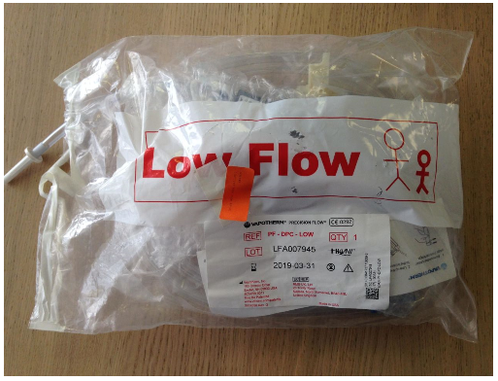
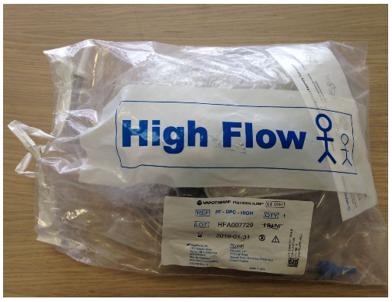
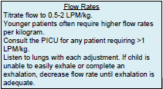

How to set up Vapotherm
Select your cartridge.
  Lower flow cartridge delivers flow rates of 1-8 L.
  Higher flow cartridge delivers flow rates of 5-40 L.
  How much flow do you anticipate using?

Slide 35
How to set up Vapotherm
2. Plug oxygen and air into the wall.

Slide 36
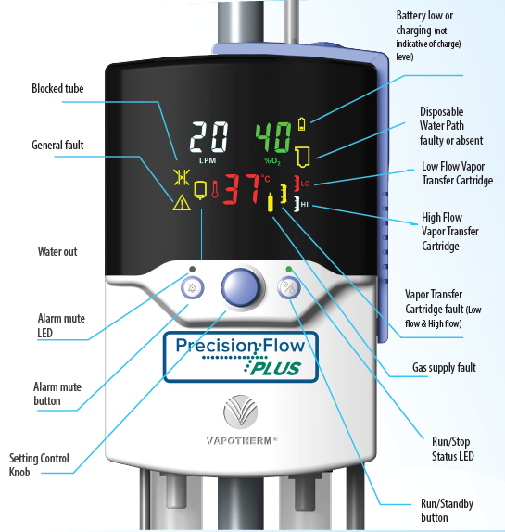
How to set up Vapotherm
3. Plug in the machine.
The machine begins in Sleep Mode.
The circled light will be yellow/amber.
The screen will be blank.

Slide 37
How to set up Vapotherm
4. Attach the cartridge to the Disposable Water Path (the big plastic thing):
Pull the cylinder out of the bag. (This is the metal thing.) Remove the rubber caps.
This plugs into the Disposable Water Path and clicks in.

Slide 38
How to set up Vapotherm
5. Attach the tubing to the Disposable Water Path (the plastic thing).
It will click into place.
Open the side door to the Vapotherm unit and slide the whole thing in.

Slide 39
How to set up Vapotherm
6. Attach the water:
Make sure the clamp on the tubing is CLOSED.
Wipe the spike with an alcohol pad.
Spike the bag of sterile water.
Hang the bag.
Open the clamp.
Let the water flooooow…

Slide 40
How to set up Vapotherm
7. Rotate the knob. This will put the machine into Standby Mode.
The screen will come on.

Slide 41

How to set up Vapotherm
8. Choose your settings:
Flow: 0.5-2 L/kg
FiO₂: usually start at 50%.
Temperature: 37°

Slide 42
How to set up Vapotherm
9. Press the Standby button.
The machine will beep.
The yellow light will flash green at first.
When the light is a solid green, the
machine is ready for business!
Check the patient end of the tubing –
you should be able to hear and feel flow.

Slide 43
How to set up Vapotherm
10. Attach the Vapotherm nasal cannula to the baby’s face.
Choose a cannula that does not occlude more than 50% of the nares.

Slide 44
How to set up Vapotherm
11. Wait for the temperature to get to 37°.
Then attach the cannula tubing to the machine tubing.
Congratulations! Your patient is now on HFNC!

Slide 45
